Slide 1

Dynamic & Proactive Organic Farming
Group No. 9
Group members StudentId
1.Pranit Kadlag 16204005
2.Subodh Khobrekar 16204007
3.Kunal Band 16204004
4.Rahul Vishwakarma 16204020
Project Guide and Co-guide
Prof. Sunil Sushir
Prof. Anagha Aher

Slide 2
Contents
Introduction
Abstract
Proposed System Architecture/Working
Technology Stack
Project Planning
References

Slide 3
Introduction
The term “organic” refers to the way agricultural products are grown and processed. Organic produce and other organic ingredients in retail products are grown without the use of synthetic pesticides and fertilizers, sewage sludge, genetically modified organisms or ionizing radiation[4].
Proposed System provide online product which are growth in natural way so, anyone can buy it online and eat healthy food which help them to stay fit. Also it provide great profitability to farmers.

Slide 4
Abstract
There are food available in market which is made by using many artificial fertilizers. In our propose system products get available which are grown without chemical fertilizer and made available for customers in a good price. so, this system help farmers to ensure greater profitability through direct farmer to supplier. In our proposed website customer , vendor/farmer have their separate login and they can add or buy product online and also have forum for farmer support.

Slide 5
Proposed System
In proposed system products service available 24x7.
    Online accessible for 24x7.
    Can add or buy product 24x7.
Email notification.
    Email notification for new offers.
    Invoice for buy product.
Forum for Farmers.
    Farmers can add any queries .
    Anyone can provide solution who knows about it.
Online payment.

Slide 6
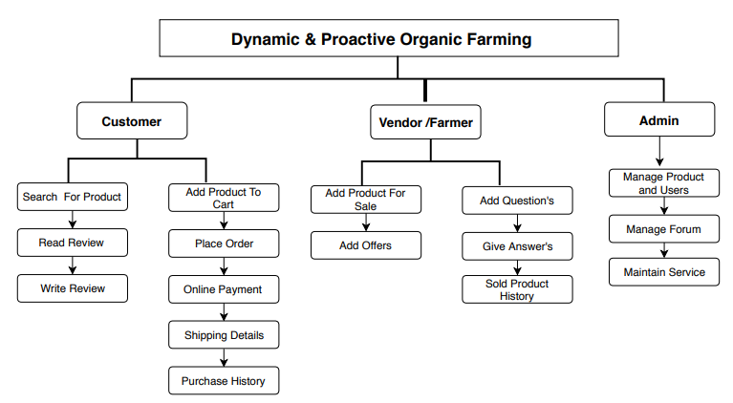
Workflow :-

Slide 7
Technology Stack
Design:-HTML,Css,bootstrap
Server side :-php
Java:- Javascript,jquery
Database:-Mysql,mongodb
Google Analytics
Artificial Intelligence and Machine Learning

Slide 8
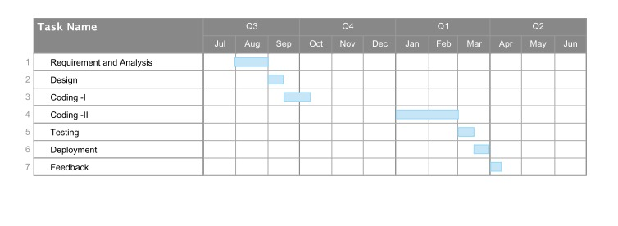
Project Planning

Slide 9
References
[1] Duc Duong, Hanh Tan, Son Pham “Customer gender based prediction on ecommerce data”, Faculty of Information Technology,2016.
[2] S.Wilson Prakash, Dr.P. Deepalakshmi “Server based Dynamic load balancing”, Department of Computer Science and Engineering,Kalasalingam University,20-22 july,2017.
[3] Mr. Sunil A. Sushir, Ms. Rujata Chaudhari “Survey of Electronic Payment Systems”, Asst. Prof., Department of Information Technology,A. P. Shah Institute of Technology,April 20-21, 2018.
[4] http://www.zbnfonline.org

Slide 10


Slide 11
Thank You...!!

